Slide 1
Bounding deviations from the mean
CS5330: Randomized Algorithms
Lecture 3
28/01/2020

Slide 2
Admin stuff
Week 3 problem set out
Optional problems for Weeks 1 & 2 (really!) out
Some notes for Week 2 lecture uploaded. Will post similar material for future lectures to supplement slides.

Slide 3
Today’s Agenda
Techniques for proving error event happens with small probability: Markov’s inequality, Chebyshev’s inequality
Applications: Count-min sketch, Count sketch, Randomized median finding

Slide 4

Expectations not the whole story!
$$𝔼X=0$$

Slide 5


Expectations not the whole story!
1/2
1/2
$$−K$$
$$𝔼X=0$$
$$K$$

Slide 6


Expectations not the whole story!
$$≈1$$
$$−∞$$
$$𝔼X=0$$
$$K$$

Slide 7

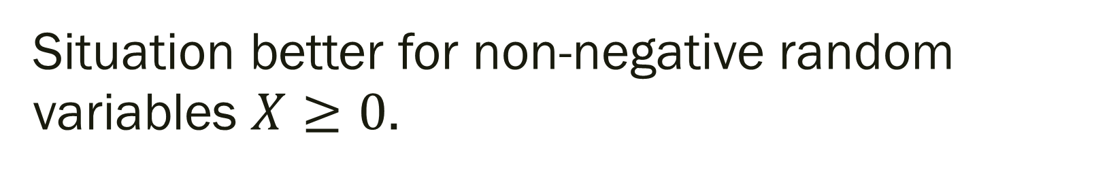

Situation better for non-negative random variables $X≥0$.
$$0$$
$$𝔼X=μ$$
$$K$$

Slide 8


Situation better for non-negative random variables $X≥0$.
$$1−μ/K$$
$$μ/K$$
$$0$$
$$𝔼X=μ$$
$$K$$

Slide 9
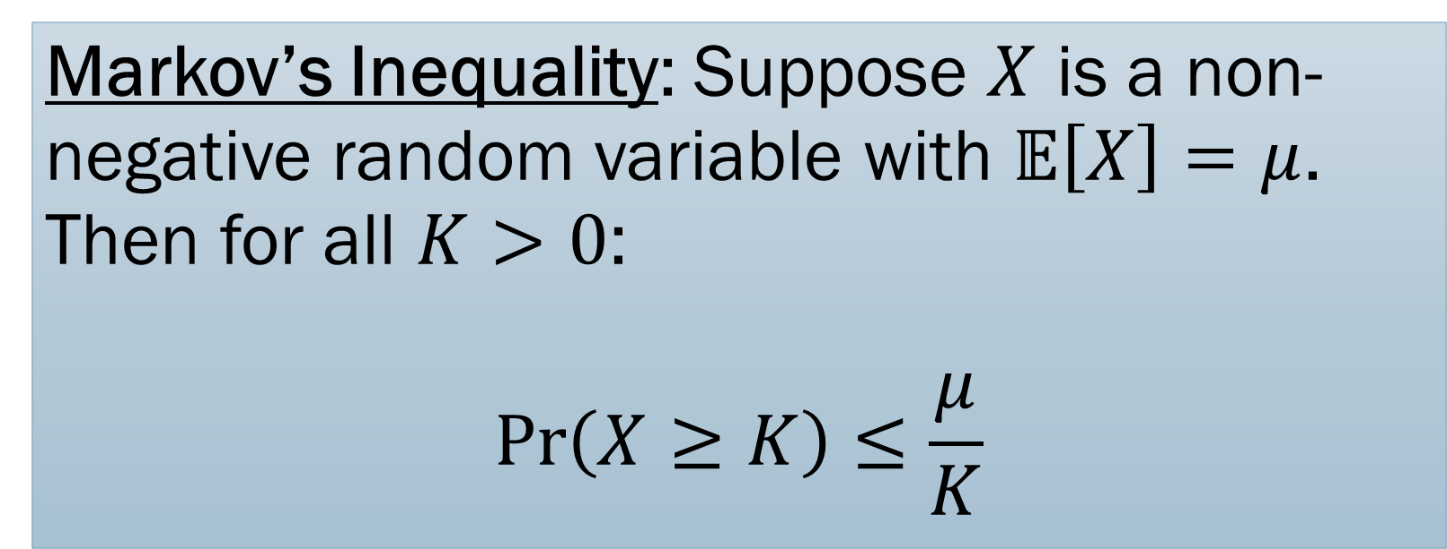
Markov’s Inequality: Suppose $X$ is a non-negative random variable with $𝔼\left[X\right]=μ$. Then for all $K>0$:
$$\operatorname{Pr}\left(X≥K\right)≤\frac{μ}{K}$$

Slide 10
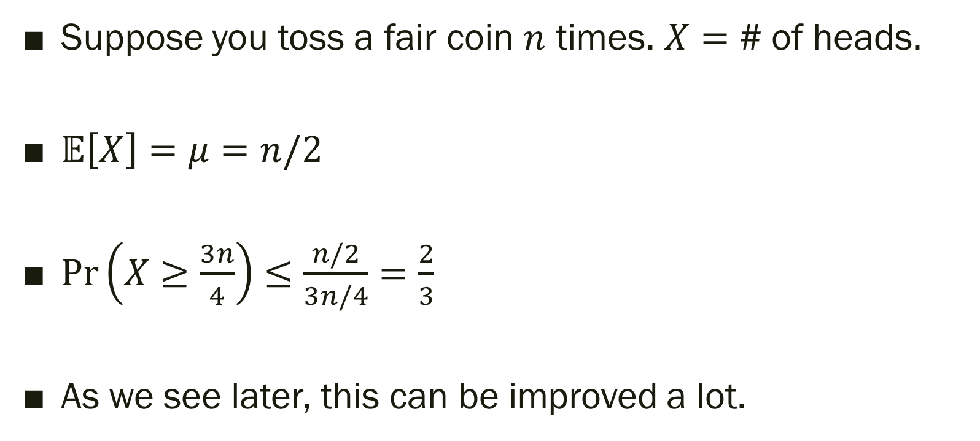
Coin Tosses
Suppose you toss a fair coin $n$ times. $X=$ # of heads.
$𝔼\left[X\right]=μ=n/2$
$\operatorname{Pr}\left(X≥\frac{3n}{4}\right)≤\frac{n/2}{3n/4}=\frac{2}{3}$
As we see later, this can be improved a lot.

Slide 11
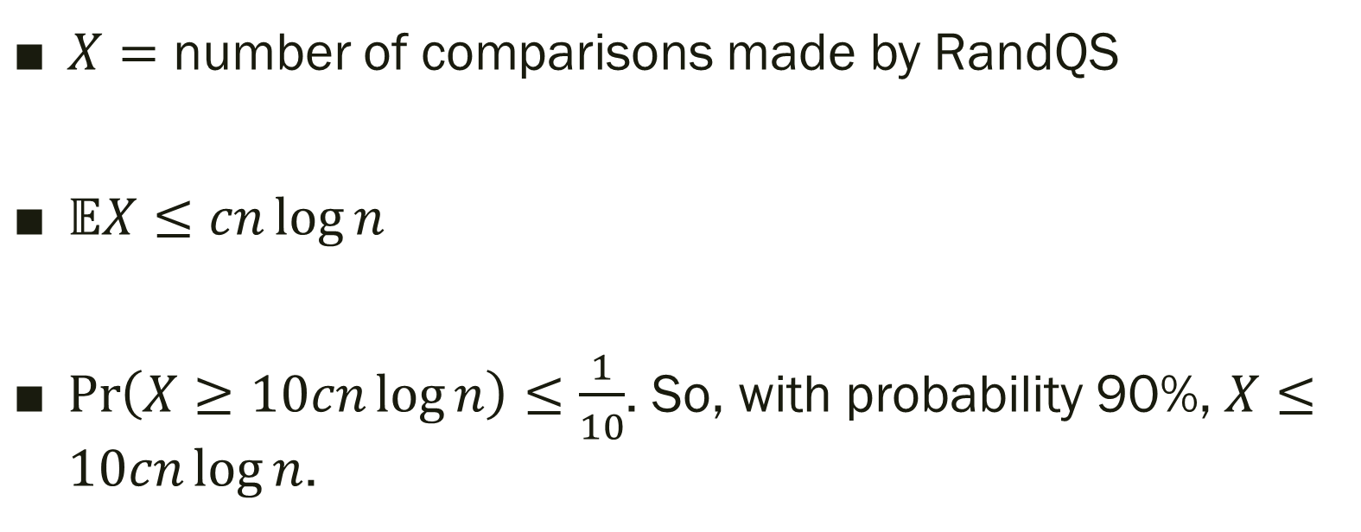
Randomized QuickSort
$X=$ number of comparisons made by RandQS
$𝔼X≤cn\log{n}$
$\operatorname{Pr}\left(X≥10cn\log{n}\right)≤\frac{1}{10}$. So, with probability 90%, $X≤10cn\log{n}$.

Slide 12
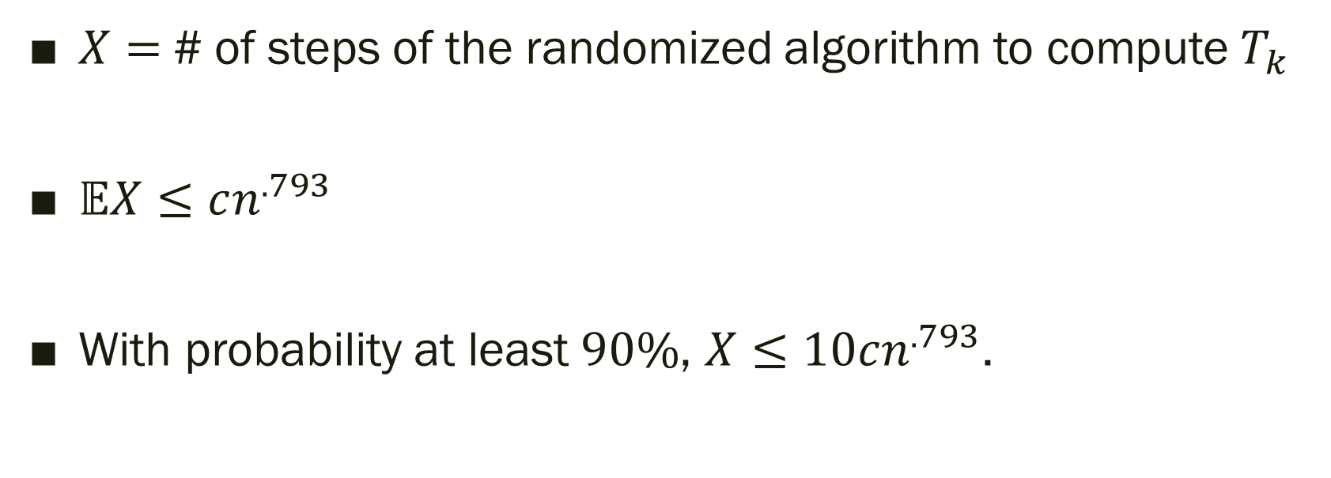
AND/OR Tree
$X=$# of steps of the randomized algorithm to compute $T_{k}$
$𝔼X≤cn^{.793}$
With probability at least $90\%$, $X≤10cn^{.793}$.

Slide 13
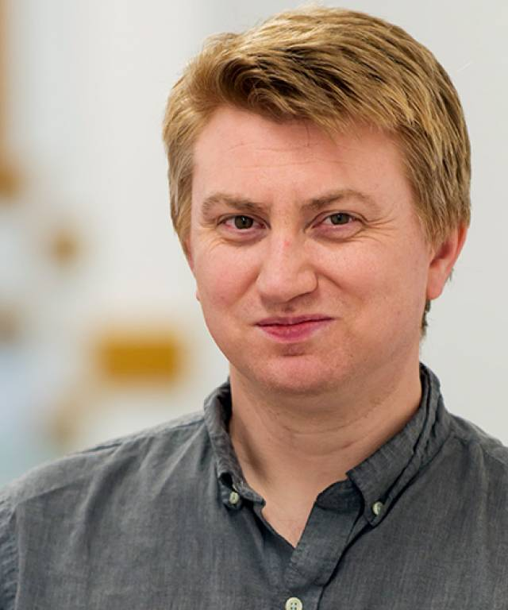

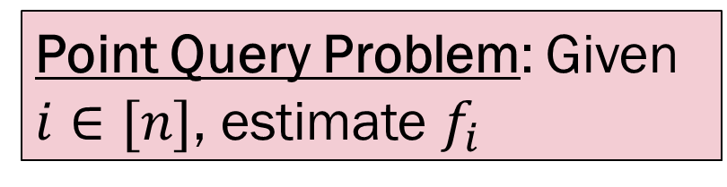
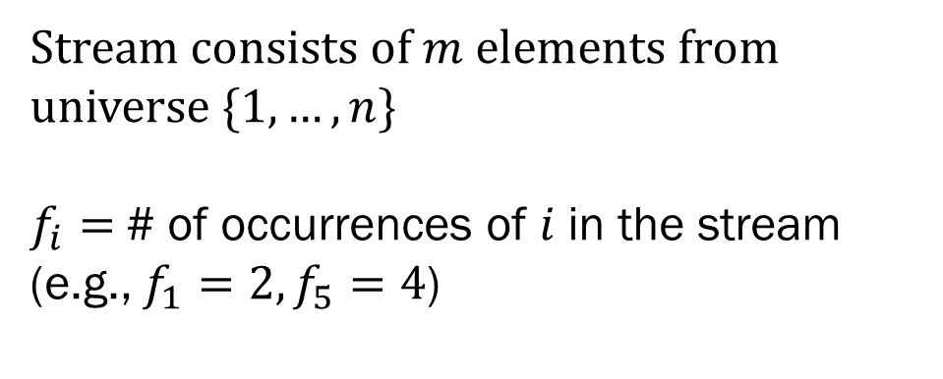
Count-Min Sketch
Monitor
2 | 1 | 5 | 5 | 3 | 4 | 5 | 1 | 5 | …
Data Stream
Cormode & Muthukrishnan. “An improved data stream summary: the count-min sketch and its applications”. J. Algorithms. 2005.
Stream consists of $m$ elements from universe $\{1, …, n\}$
$f_{i}=$# of occurrences of $i$ in the stream (e.g., $f_{1}=2, f_{5}=4$)
Point Query Problem: Given $i∈[n]$, estimate $f_{i}$

Slide 14
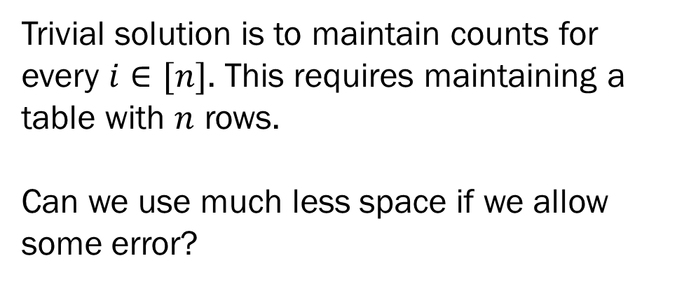
Count-Min Sketch
Monitor
2 | 1 | 5 | 5 | 3 | 4 | 5 | 1 | 5 | …
Data Stream
Cormode & Muthukrishnan. “An improved data stream summary: the count-min sketch and its applications”. J. Algorithms. 2005.
Trivial solution is to maintain counts for every $i∈[n]$. This requires maintaining a table with $n$ rows.
Can we use much less space if we allow some error?
Point Query Problem: Given $i∈[n]$, estimate $f_{i}$

Slide 15




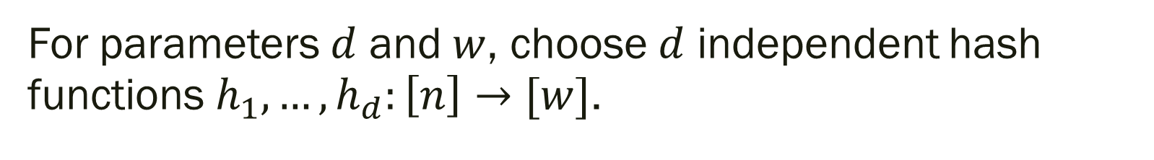


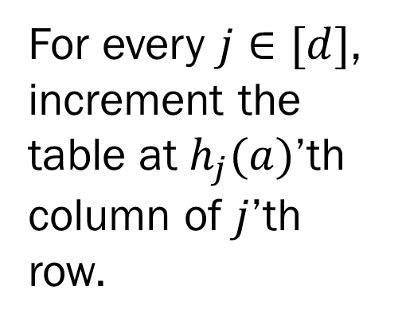


Count-Min Sketch
For parameters $d$ and $w$, choose $d$ independent hash functions $h_{1},…, h_{d}:\left[n\right]→[w]$.
$$1$$
$$2$$
$$w$$
$$h_{1}$$
For every $j∈[d]$, increment the table at $h_{j}(a)$’th column of $j$’th row.
$$h_{2}$$
$$M$$
$$a$$
$$h_{d}$$
Given a query $i$, output ${\hat{f}}_{i}=\min_{j∈[d]}{M\left[j\right][h_{j}\left(i\right)]}$

Slide 16

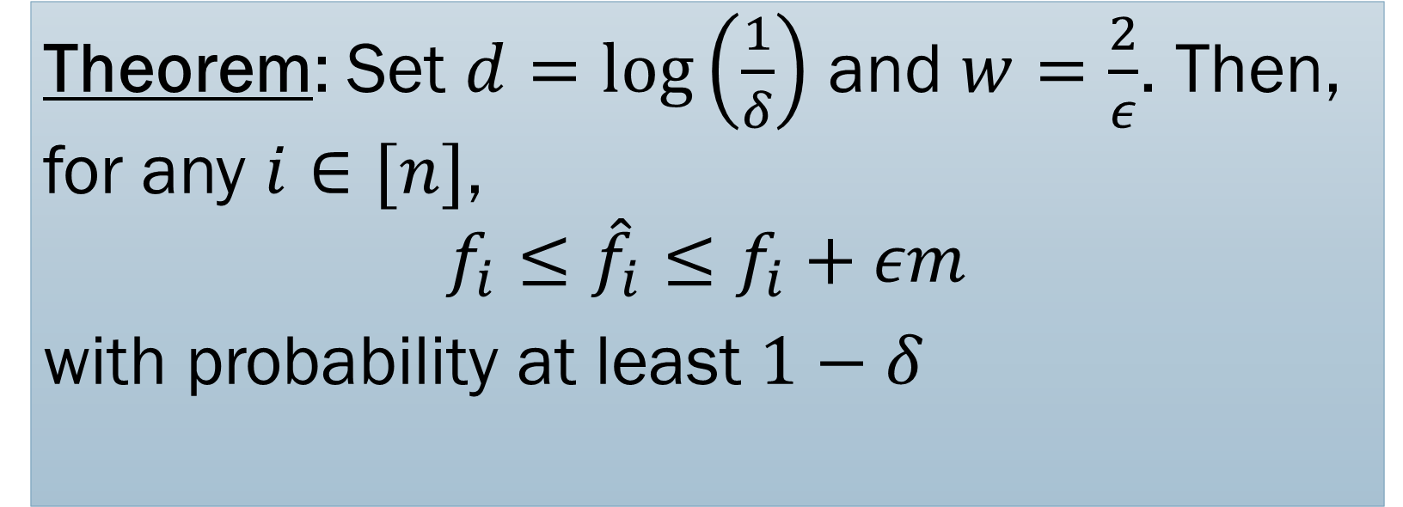
Theorem: Set $d=\log\left(\frac{1}{δ}\right)$ and $w=\frac{2}{ε}$. Then, for any $i∈[n]$,
$$f_{i}≤{\hat{f}}_{i}≤f_{i}+εm$$
with probability at least $1−δ$
Space needed: $O\left(ε^{−1}\log{m}\log{δ^{−1}}\right)+$cost of storing hash functions

Slide 17
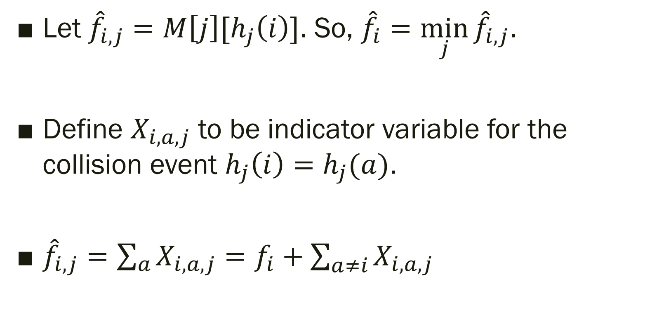
Defining Random Variables
Let ${\hat{f}}_{i,j}=M\left[j\right][h_{j}\left(i\right)]$. So, ${\hat{f}}_{i}=\min_{j}{{\hat{f}}_{i,j}}$.
Define $X_{i,a,j}$ to be indicator variable for the collision event $h_{j}\left(i\right)=h_{j}(a)$.
${\hat{f}}_{i,j}=\sum_{a}{X_{i,a,j}}=f_{i}+\sum_{a≠i}{X_{i,a,j}}$

Slide 18
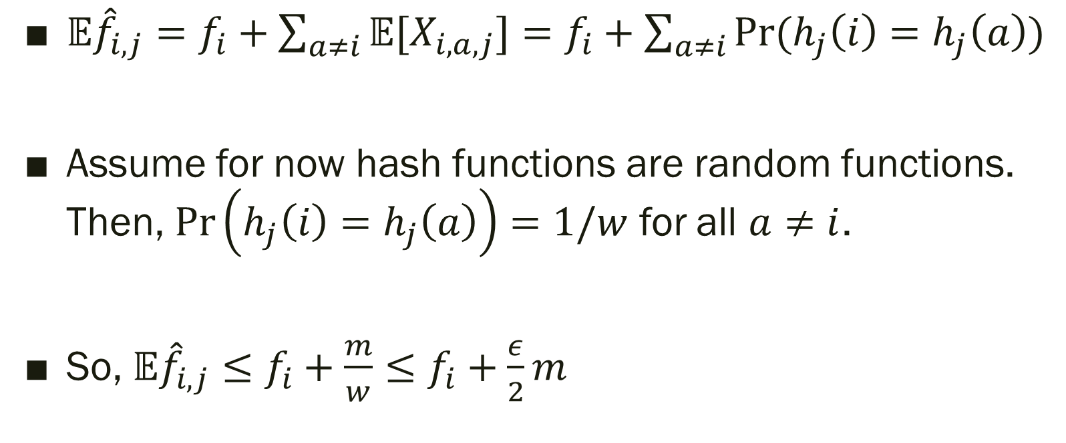
Expectation Analysis
$𝔼{\hat{f}}_{i,j}=f_{i}+\sum_{a≠i}{𝔼[X_{i,a,j}]}=f_{i}+\sum_{a≠i}{Pr⁡(h_{j}\left(i\right)=h_{j}\left(a\right))}$
Assume for now hash functions are random functions. Then, $\operatorname{Pr}\left(h_{j}\left(i\right)=h_{j}\left(a\right)\right)=1/w$ for all $a≠i$.
So, $𝔼{\hat{f}}_{i,j}≤f_{i}+\frac{m}{w}≤f_{i}+\frac{ε}{2}m$

Slide 19
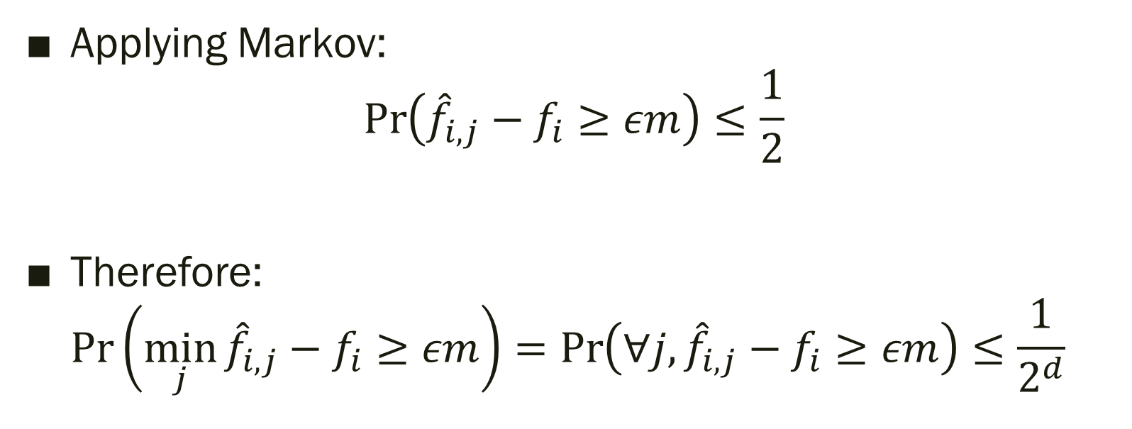
Deviation Bound Analysis
Applying Markov:
$\operatorname{Pr}\left({\hat{f}}_{i,j}−f_{i}≥εm\right)≤\frac{1}{2}$
Therefore:
$\operatorname{Pr}\left(\min_{j}{{\hat{f}}_{i,j}−f_{i}}≥εm\right)=\operatorname{Pr}\left(∀j,{\hat{f}}_{i,j}−f_{i}≥εm\right)≤\frac{1}{2^{d}}=δ$

Slide 20
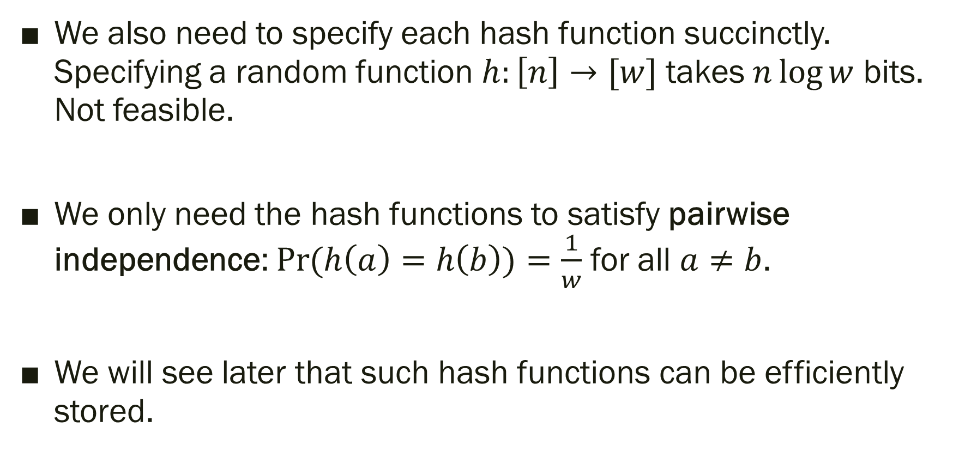
Hash Functions
We also need to specify each hash function succinctly. Specifying a random function $h:\left[n\right]→[w]$ takes $n\log{w}$ bits. Not feasible.
We only need the hash functions to satisfy pairwise independence: $\operatorname{Pr}{(h\left(a\right)=h\left(b\right))}=\frac{1}{w}$ for all $a≠b$.
We will see later that such hash functions can be efficiently stored.

Slide 21
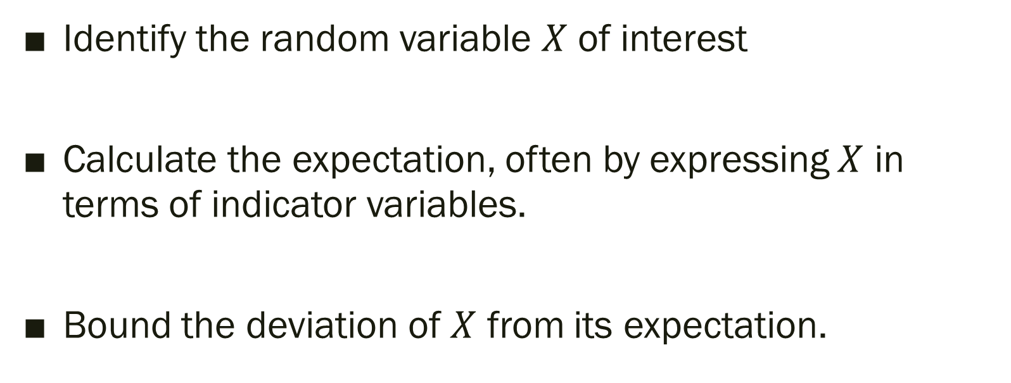
Typical Template for Analysis
Identify the random variable $X$ of interest
Calculate the expectation, often by expressing $X$ in terms of indicator variables.
Bound the deviation of $X$ from its expectation.
Caveat: Sometimes the reverse order may be useful!

Slide 22
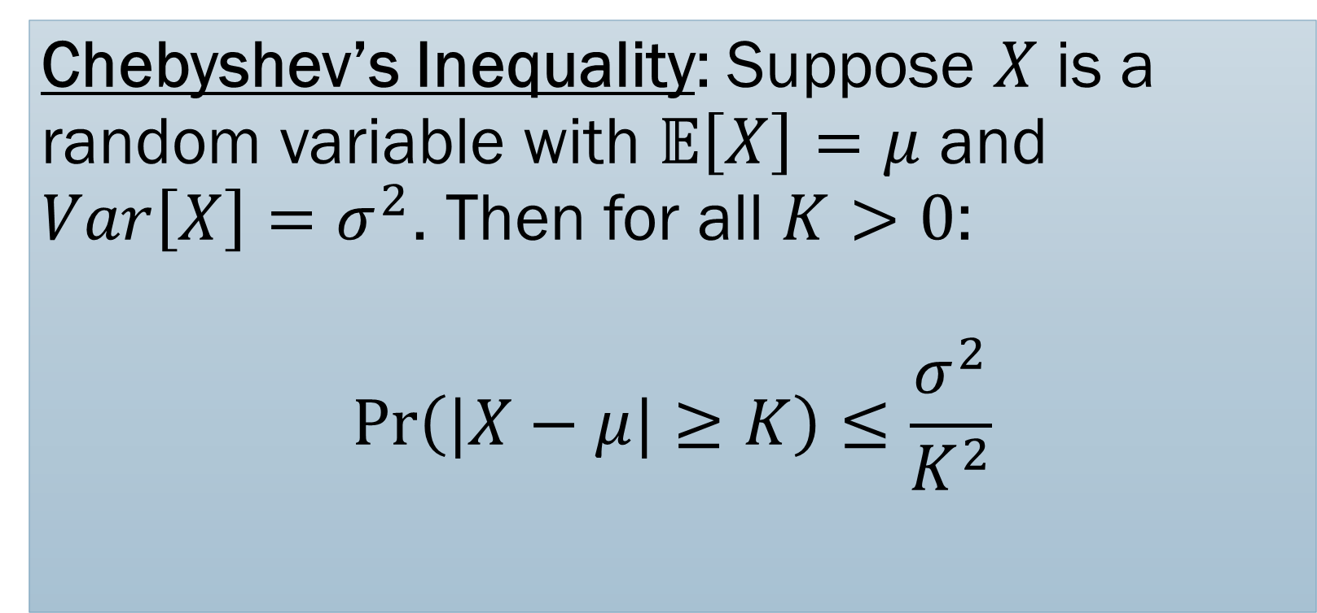
Chebyshev’s Inequality: Suppose $X$ is a random variable with $𝔼\left[X\right]=μ$ and $Var\left[X\right]=σ^{2}$. Then for all $K>0$:
$$\operatorname{Pr}\left(|X−μ|≥K\right)≤\frac{σ^{2}}{K^{2}}$$

Slide 23
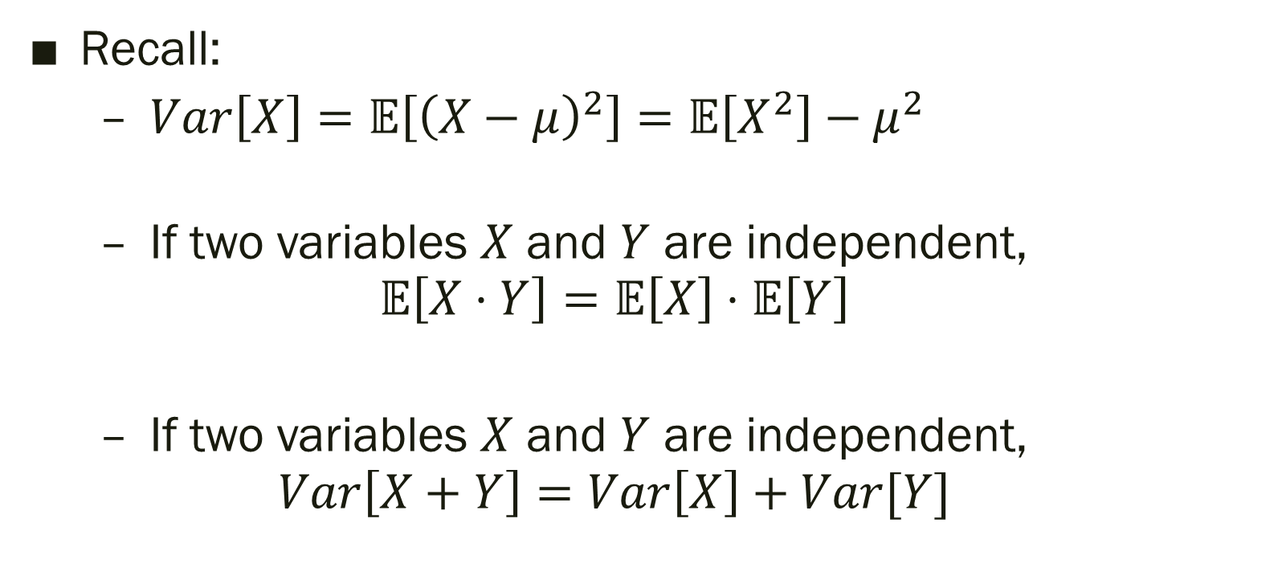
Useful Facts
Recall:
  $Var\left[X\right]=𝔼\left[{\left(X−μ\right)}^{2}\right]=𝔼\left[X^{2}\right]−μ^{2}$
  If two variables $X$ and $Y$ are independent,
  $𝔼\left[X⋅Y\right]=𝔼\left[X\right]⋅𝔼\left[Y\right]$
  If two variables $X$ and $Y$ are independent,
  $Var\left[X+Y\right]=Var\left[X\right]+Var[Y]$

Slide 24
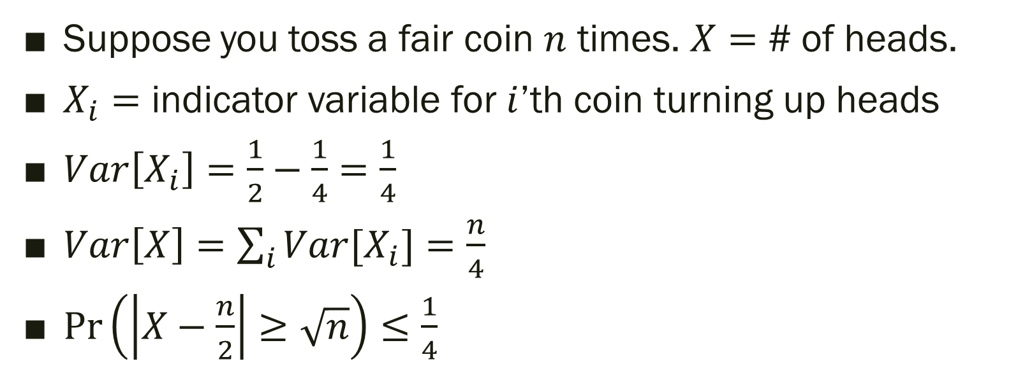
Coin Tosses
Suppose you toss a fair coin $n$ times. $X=$ # of heads.
$X_{i}=$ indicator variable for $i$’th coin turning up heads
$Var\left[X_{i}\right]=\frac{1}{2}−\frac{1}{4}=\frac{1}{4}$
$Var\left[X\right]=\sum_{i}{Var[X_{i}]}=\frac{n}{4}$
$\operatorname{Pr}\left(\left|X−\frac{n}{2}\right|≥\sqrt{n}\right)≤\frac{1}{4}$

Slide 25
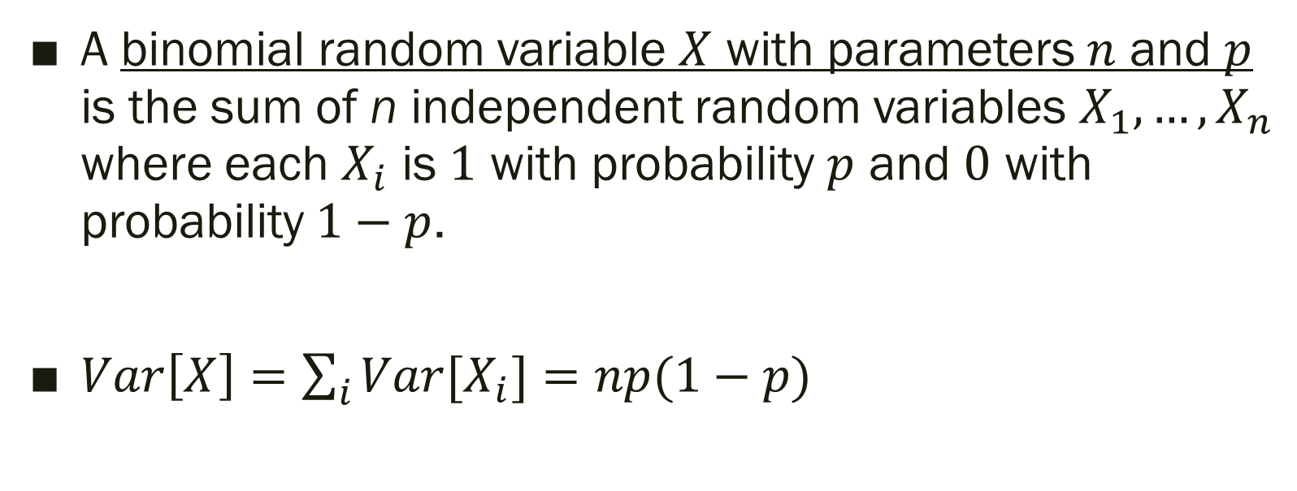
Binomial Random Variables
A binomial random variable $X$ with parameters $n$ and $p$ is the sum of n independent random variables $X_{1},…, X_{n}$ where each $X_{i}$ is $1$ with probability $p$ and $0$ with probability $1−p$.
$Var\left[X\right]=\sum_{i}{Var[X_{i}]}=np(1−p)$

Slide 26
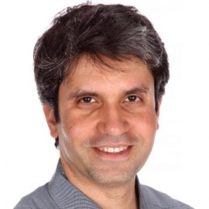
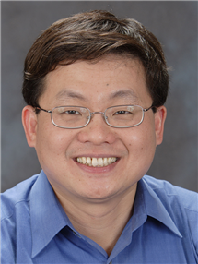
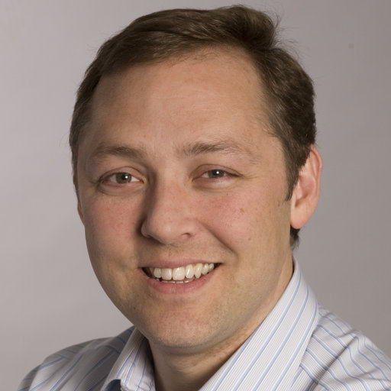
Count Sketch
Monitor
2 | 1 | 5 | 5 | 3 | 4 | 5 | 1 | 5 | …
Charikar, Chen, Farach-Colton. “Finding Frequent Items in Data Streams”. Theoret. Comp. Sci. 2004.
Data Stream
Trivial solution is to maintain counts for every $i∈[n]$. This requires maintaining a table with $n$ rows.
Can we use much less space if we allow some error?
Point Query Problem: Given $i∈[n]$, estimate $f_{i}$

Slide 27
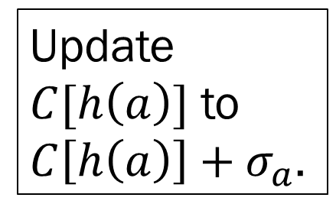


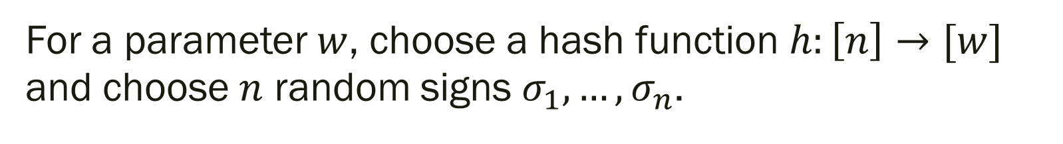



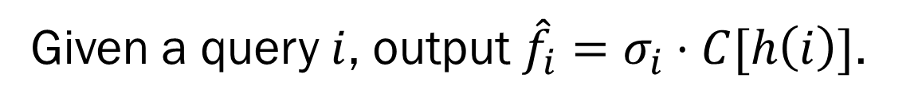
(Simplified) Count Sketch
For a parameter $w$, choose a hash function $h:\left[n\right]→[w]$ and choose $n$ random signs $σ_{1},…, σ_{n}$.
$$1$$
$$2$$
$$w$$
$$C$$
Update $C[h\left(a\right)]$ to $C\left[h\left(a\right)\right]+σ_{a}$.
$$a$$
Given a query $i$, output ${\hat{f}}_{i}=σ_{i}⋅C[h\left(i\right)]$.

Slide 28

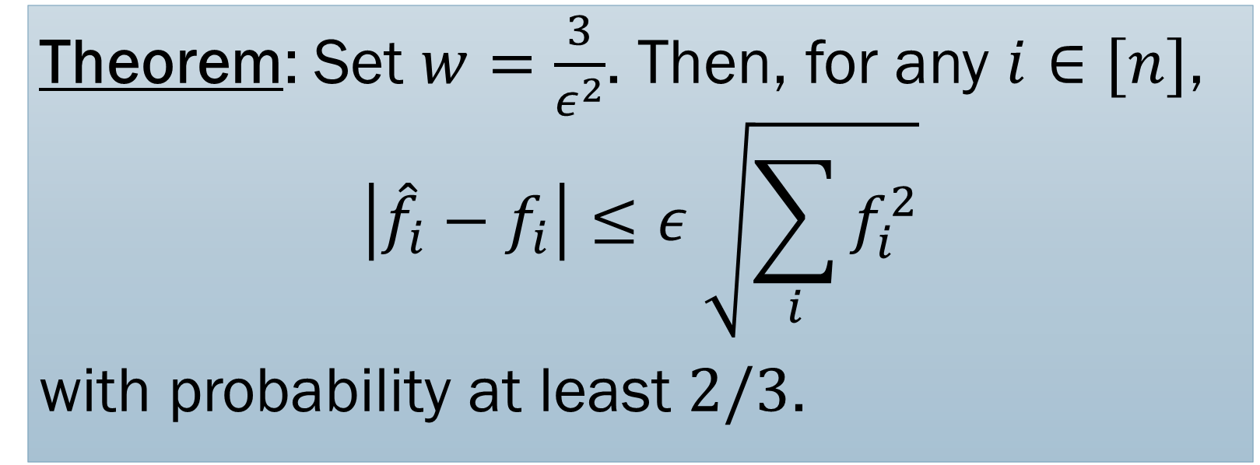
Theorem: Set $w=\frac{3}{ε^{2}}$. Then, for any $i∈[n]$,
$$\left|{\hat{f}}_{i}−f_{i}\right|≤ε \sqrt{\sum_{i}{f_{i}^{2}}}$$
with probability at least $2/3$.
Space complexity: $O\left(ε^{−2}\log{m}\right)+$ cost of storing hash function & signs.
Will see later how to boost success probability.

Slide 29
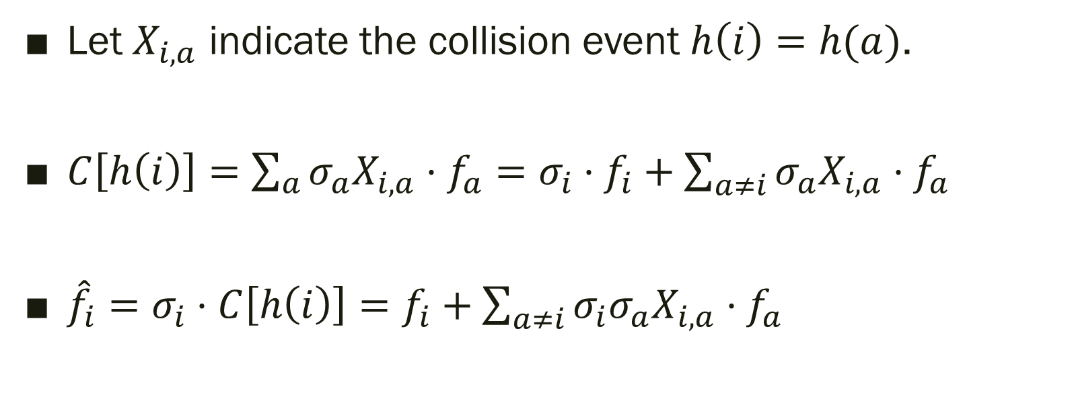
Defining Random Variables
Let $X_{i,a}$ indicate the collision event $h\left(i\right)=h(a)$.
$C\left[h\left(i\right)\right]=\sum_{a}{σ_{a}X_{i,a}⋅f_{a}}=σ_{i}⋅f_{i}+\sum_{a≠i}{σ_{a}X_{i,a}}⋅f_{a}$
${\hat{f}}_{i}=σ_{i}⋅C\left[h\left(i\right)\right]=f_{i}+\sum_{a≠i}{σ_{i}σ_{a}X_{i,a}⋅f_{a}}$

Slide 30
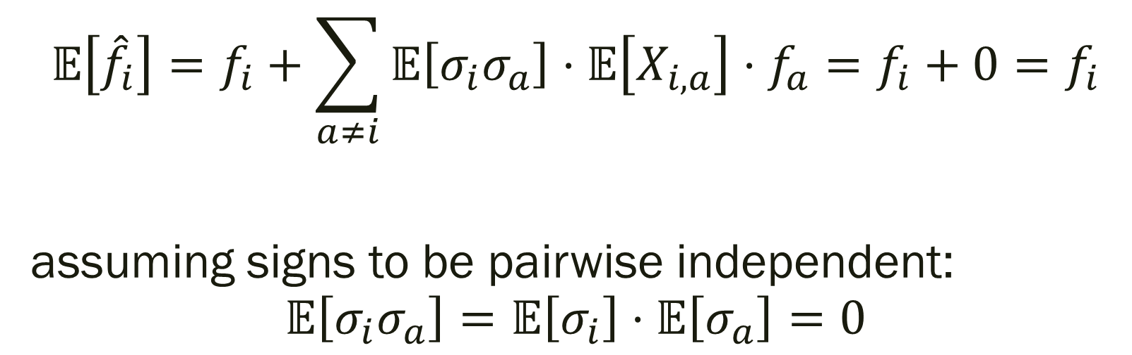
Expectation analysis
$$𝔼\left[{\hat{f}}_{i}\right]=f_{i}+\sum_{a≠i}{𝔼\left[{σ_{i}σ}_{a}\right]⋅𝔼\left[X_{i,a}\right]⋅f_{a}}=f_{i}+0=f_{i}$$
assuming signs to be pairwise independent:
$$𝔼\left[{σ_{i}σ}_{a}\right]=𝔼\left[σ_{i}\right]⋅𝔼\left[σ_{a}\right]=0$$

Slide 31
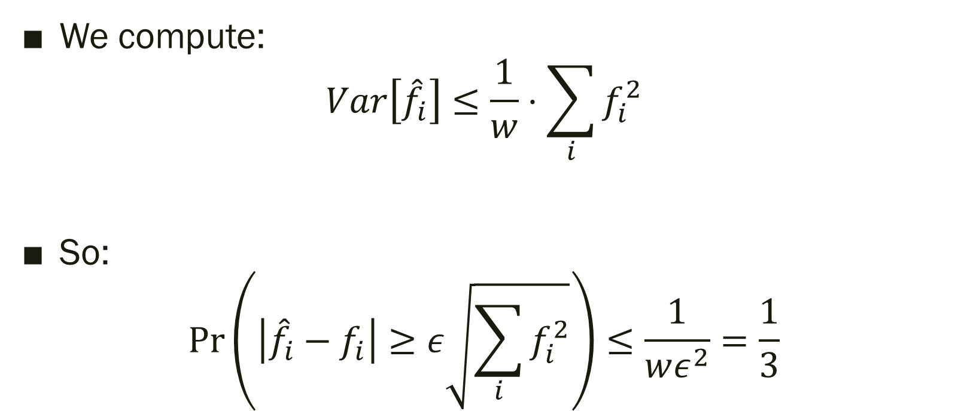
Deviation bound analysis
We compute:
$Var\left[{\hat{f}}_{i}\right]≤\frac{1}{w}⋅\sum_{i}{f_{i}^{2}}$
So:
$\operatorname{Pr}\left(\left|{\hat{f}}_{i}−f_{i}\right|≥ε\sqrt{\sum_{i}{f_{i}^{2}}}\right)≤\frac{1}{wε^{2}}=\frac{1}{3}$

Slide 32
Hash function & Signs
Again, need to have an efficient scheme to store the hash functions and signs.
Notice that we only need pairwise independence for hash functions and signs, so, as we see later, these can be stored efficiently.

Slide 33
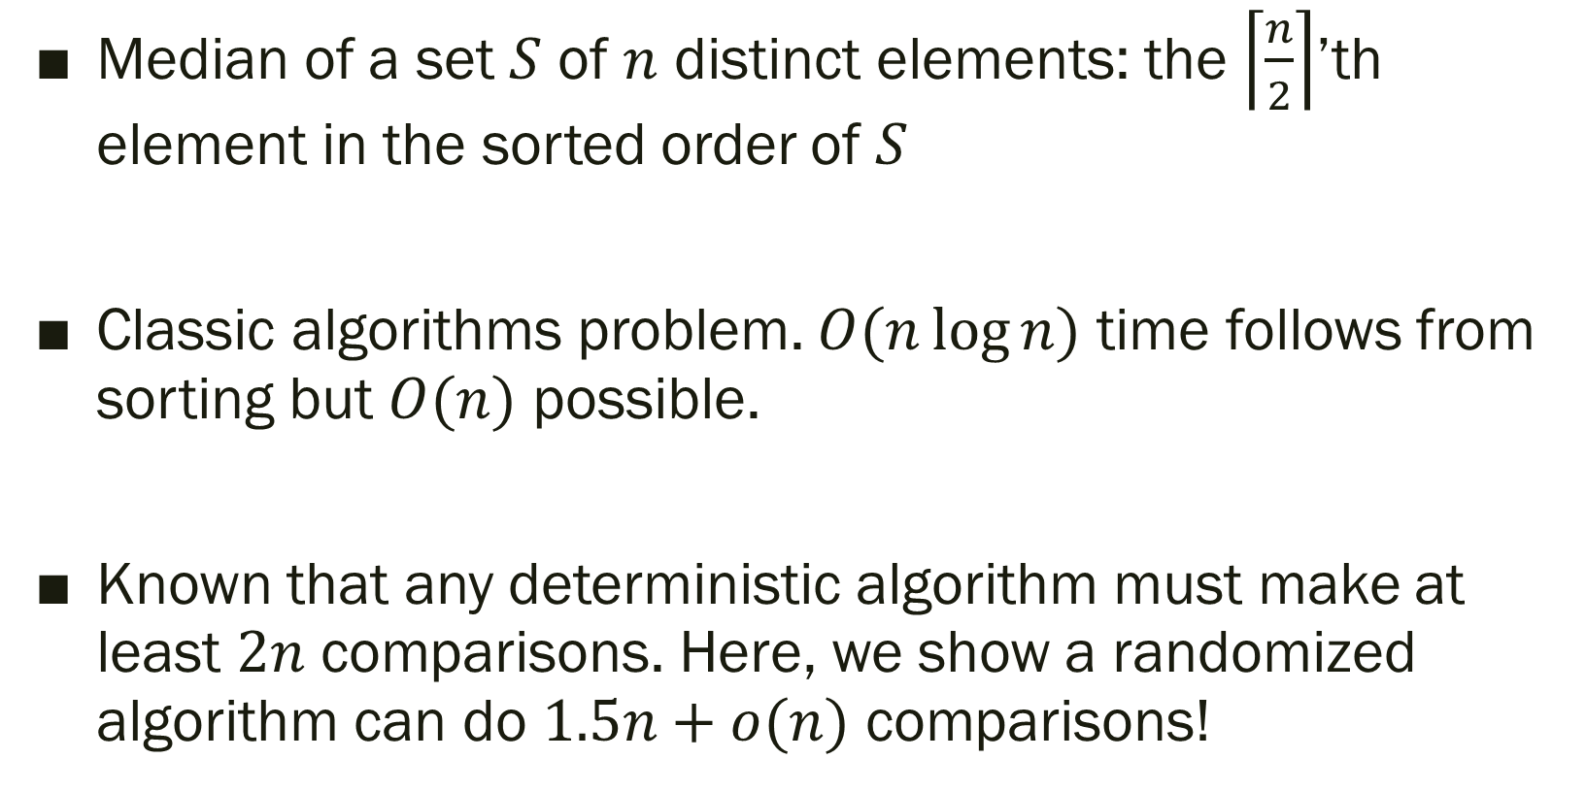
Median Finding
Median of a set $S$ of $n$ distinct elements: the $\left\lceil \frac{n}{2}\right\rceil$’th element in the sorted order of $S$
Classic algorithms problem. $O(n\log{n})$ time follows from sorting but $O(n)$ possible.
Known that any deterministic algorithm must make at least $2n$ comparisons. Here, we show a randomized algorithm can do $1.5n+o(n)$ comparisons!

Slide 34
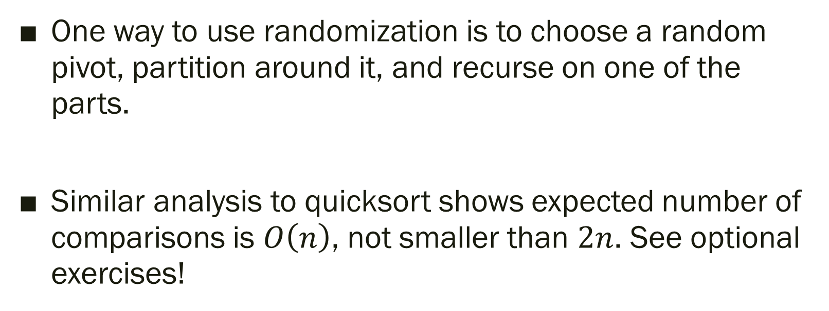
Quick Select
One way to use randomization is to choose a random pivot, partition around it, and recurse on one of the parts.
Similar analysis to quicksort shows expected number of comparisons is $O\left(n\right)$, not smaller than $2n$. See optional exercises!

Slide 35



Lazy Median
$$m$$
Sorted array
$$d$$
$$u$$
Want to pick $a$ and $b$ such that:
Want to pick 𝑎 and 𝑏 such that:
$d<m$, $u>m$.
𝑑<𝑚, 𝑢>𝑚.
There are $n^{c}$ elements larger than $d$ and smaller than $u$, for $c<1$.
There are 𝑛^𝑐 elements larger than 𝑑 and smaller than 𝑢, for 𝑐<1.

Slide 36
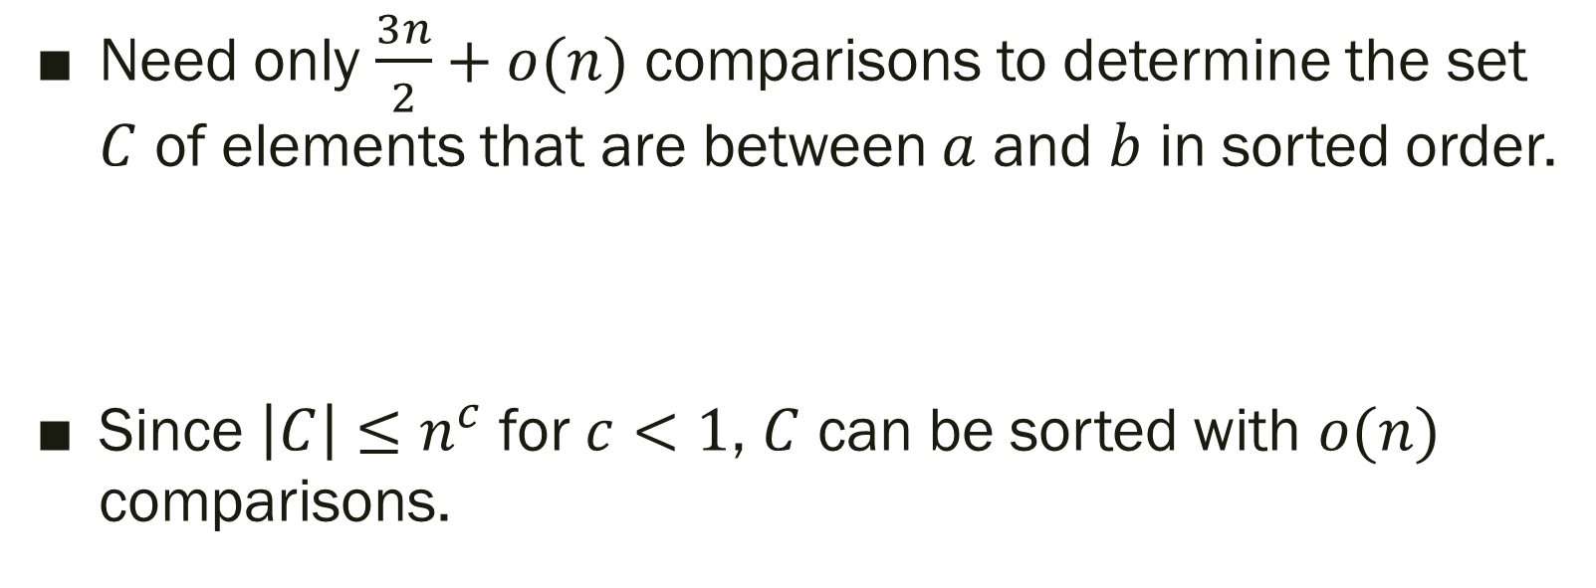
Why is this enough?
Need only $\frac{3n}{2}+o(n)$ comparisons to determine the set $C$ of elements that are between $a$ and $b$ in sorted order.
Since $\left|C\right|≤n^{c}$ for $c<1$, $C$ can be sorted with $o(n)$ comparisons.

Slide 37
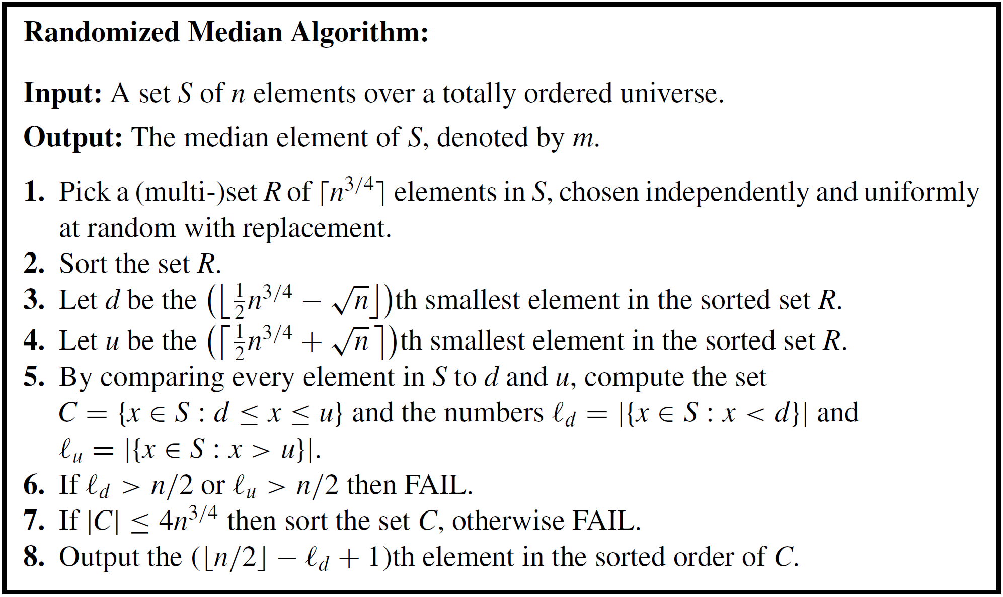

Slide 38
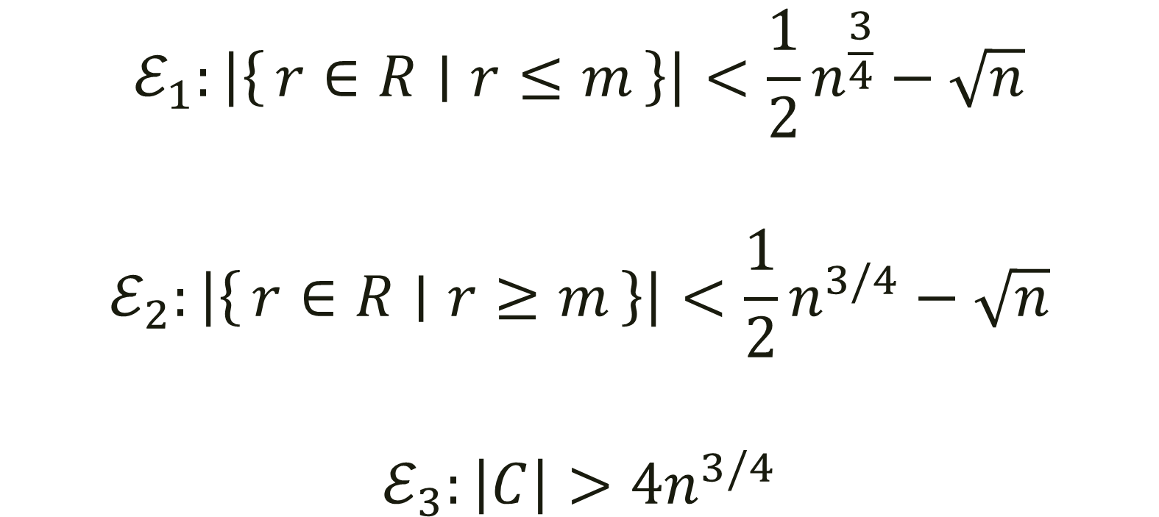
Error Events
$$ℰ_{1}:\left|\left\{r∈R ∣ r≤m\right\}\right|<\frac{1}{2}n^{\frac{3}{4}}−\sqrt{n}$$
$$ℰ_{2}:\left|\left\{r∈R ∣ r≥m\right\}\right|<\frac{1}{2}n^{3/4}−\sqrt{n}$$
$$ℰ_{3}:\left|C\right|>4n^{3/4}$$

Slide 39
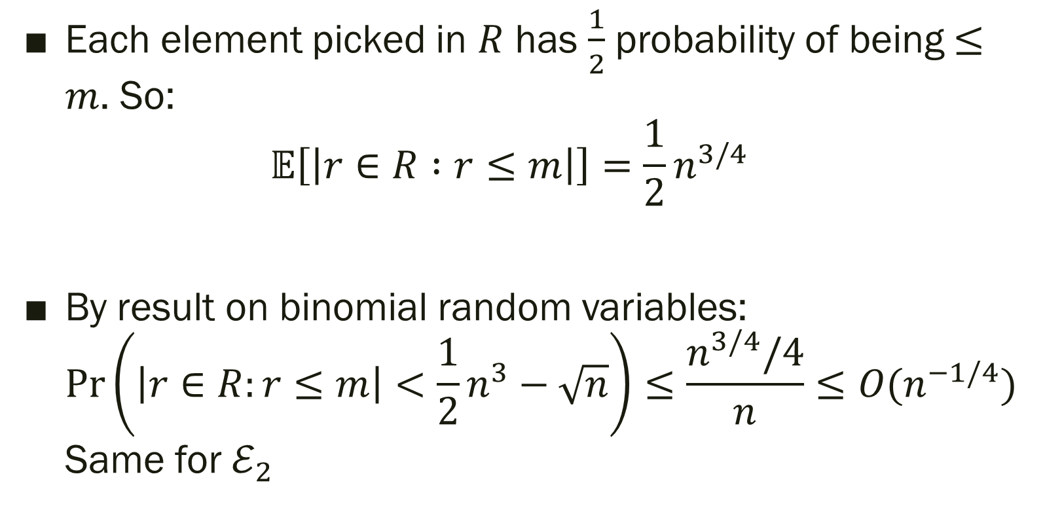
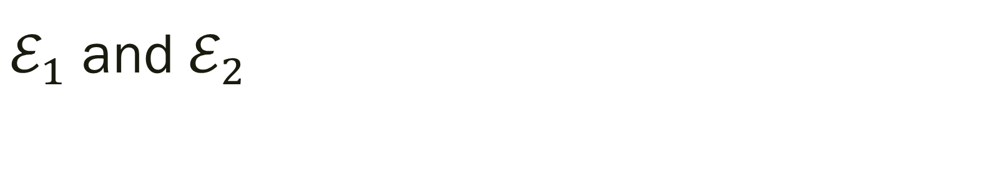
$ℰ_{1}$ and $ℰ_{2}$
Each element picked in $R$ has $\frac{1}{2}$ probability of being $≤m$. So:
$𝔼\left[\left|r∈R :r≤m\right|\right]=\frac{1}{2}n^{3/4}$
By result on binomial random variables:
$\operatorname{Pr}\left(\left|r∈R:r≤m\right|<\frac{1}{2}n^{3}−\sqrt{n}\right)≤\frac{n^{3/4}/4}{n}≤O(n^{−1/4})$
Same for $ℰ_{2}$

Slide 40
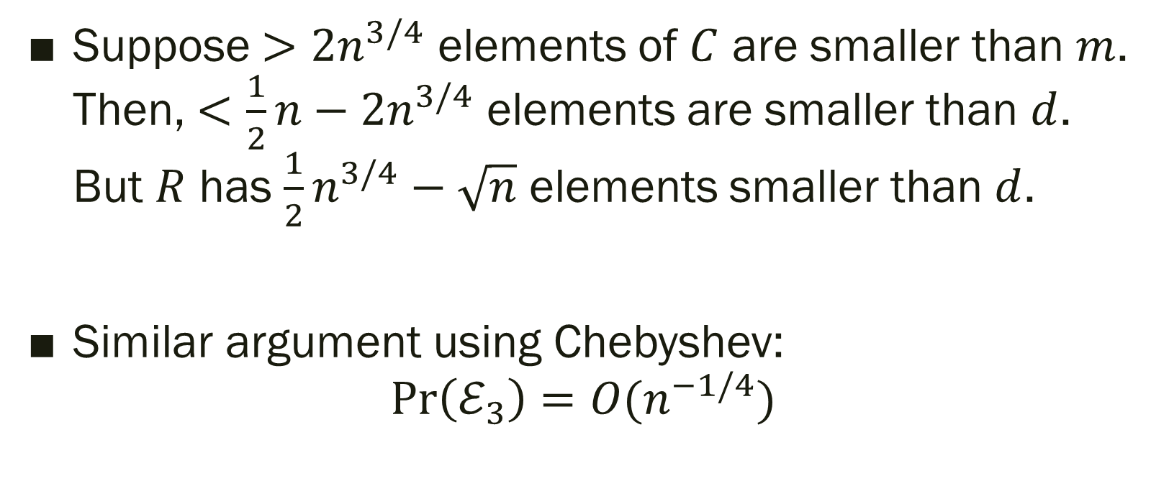
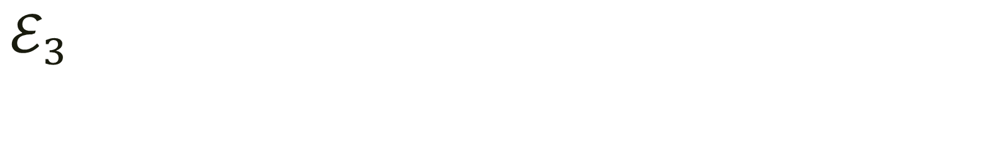
$ℰ_{3}$
Suppose $>2n^{3/4}$ elements of $C$ are smaller than $m$. Then, $<\frac{1}{2}n−2n^{3/4}$ elements are smaller than $d$. But $R$ has $\frac{1}{2}n^{3/4}−\sqrt{n}$ elements smaller than $d$.
Similar argument using Chebyshev:
$\operatorname{Pr}\left(ℰ_{3}\right)=O(n^{−1/4})$

Slide 41
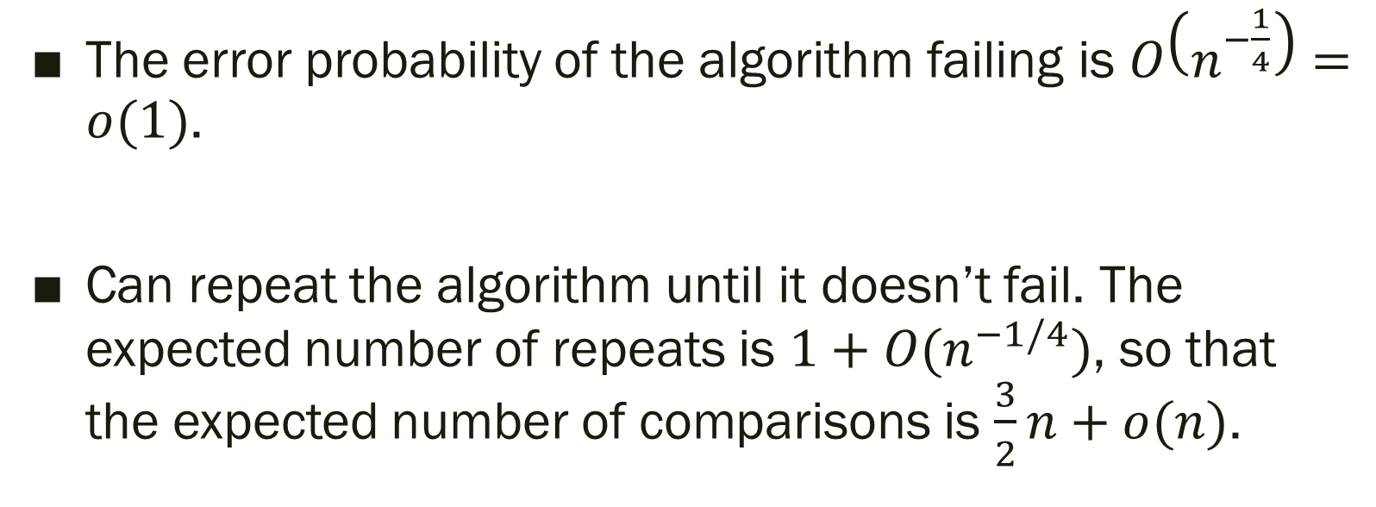
Tying everything up
The error probability of the algorithm failing is $O\left(n^{−\frac{1}{4}}\right)=o(1)$.
Can repeat the algorithm until it doesn’t fail. The expected number of repeats is $1+O(n^{−1/4})$, so that the expected number of comparisons is $\frac{3}{2}n+o(n)$.

Slide 42
Takeaways
Expectations are only part of the story. We often want an explicit bound on error events (such as high runtime or failure)
Markov inequality is the most basic tool. Chebyshev inequality enhances it by looking at second moments.
Later, we turn to the Chernoff bounds which capture all the information from moments of a random variable.

